Slide 1


Slide 2
Sampling from CompuMed Company:
Supervisors and employees write average over 5 letters, 10 memos, 50 e-mail messages, and numerous instant messages and text messages a day.
Letters and messages are written to different audiences inside and outside of the company

Slide 3
On average, an entry-level engineer at a large company like Southern California Edison (SCE) might produce the following types and quantities of written communication per week:
Estimated Weekly Output:
Emails: 50–150 (Mostly short, internal communication with team members, managers, and other departments.)
Memos: 1–3 (Internal documents about project updates, safety notes, or process clarifications.)
Reports: 0.25–1 (Typically contributes to a larger team report monthly or writes small standalone reports.)
Letters (formal external communication): Rare (Maybe 1 per month or less; handled more often by legal, regulatory, or senior staff.)

Slide 4
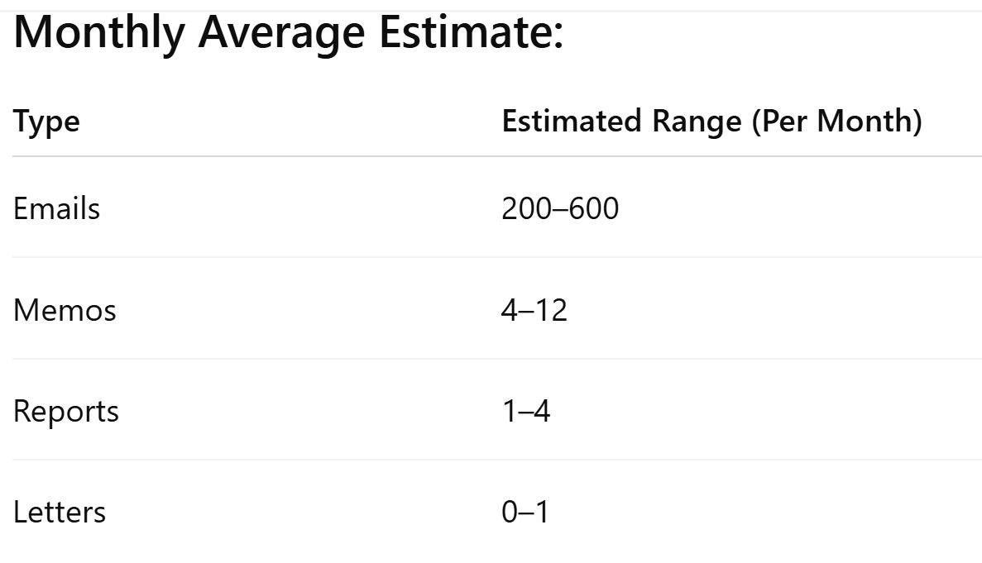
Southern California Edison (SCE)
The actual numbers depend heavily on the specific role (e.g., field engineer vs. design vs. compliance), project phase, and department.

Slide 5
Writing Common Engineering Documents
Letters of inquiry to retailers seeking product information (technical specifications, pricing, warranties, guarantees, credentials of service staff, and so forth)
Cover letters prefacing CompuMed’s proposals
Complaint letters written to parts-manufacturers if and when faulty equipment and materials are received in shipping and adjustment letters to compensate retailers when problems occur
Memos to accomplish a variety of goals
Document work accomplished
Call meetings and establish meeting agendas
Request equipment from purchasing
Preface internal proposals

Slide 6

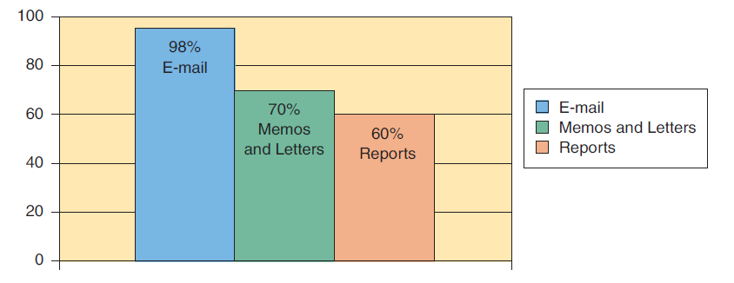
Percentage of Employees Who Consider E-mail, Memos, Letters, and Reports “Extremely Important”

Slide 7
Which Communication Channel Should You Use?
Memos, letters, and e-mail messages are three common types of communication channels.
Other communication channels include reports, Web sites, blogs, PowerPoint presentations, oral communication, instant messages, text messages, and more.
When should you write an e-mail message instead of a memo?
When should you write a memo instead of a letter?
Is an instant message or a text message appropriate to the situation?

Slide 8
Which Communication Channel Should You Use?
For example, e-mail is a convenient communication channel.
E-mail might not be the best communication channel to use if you are discussing a highly sensitive topic such as a pending merger, corporate takeover, or layoffs,
An e-mail message would be less secure than a letter sent in a sealed envelope.

Slide 9
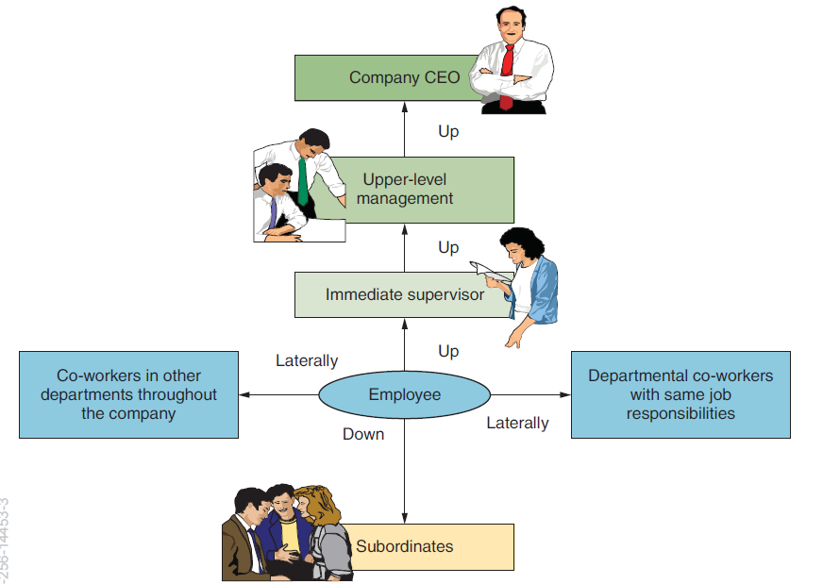

Slide 10
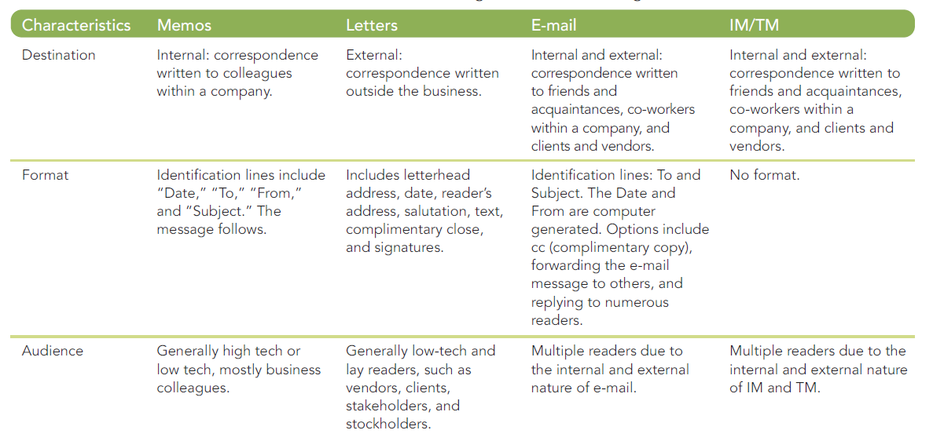
Writing Common Engineering Documents
Instant messages (IM), and text messages(TM),

Slide 11
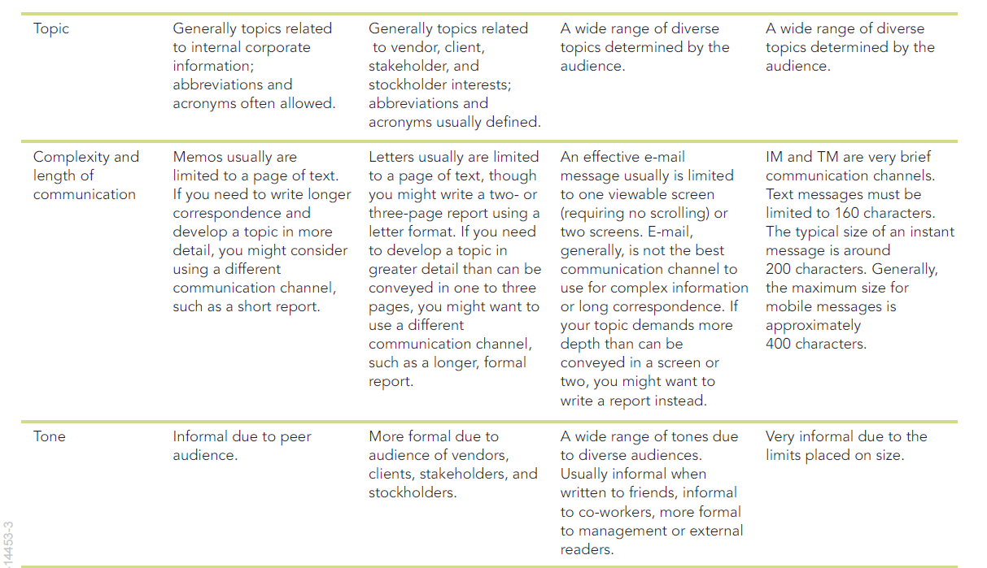
Writing Common Engineering Documents
Instant messages (IM), and text messages(TM),

Slide 12
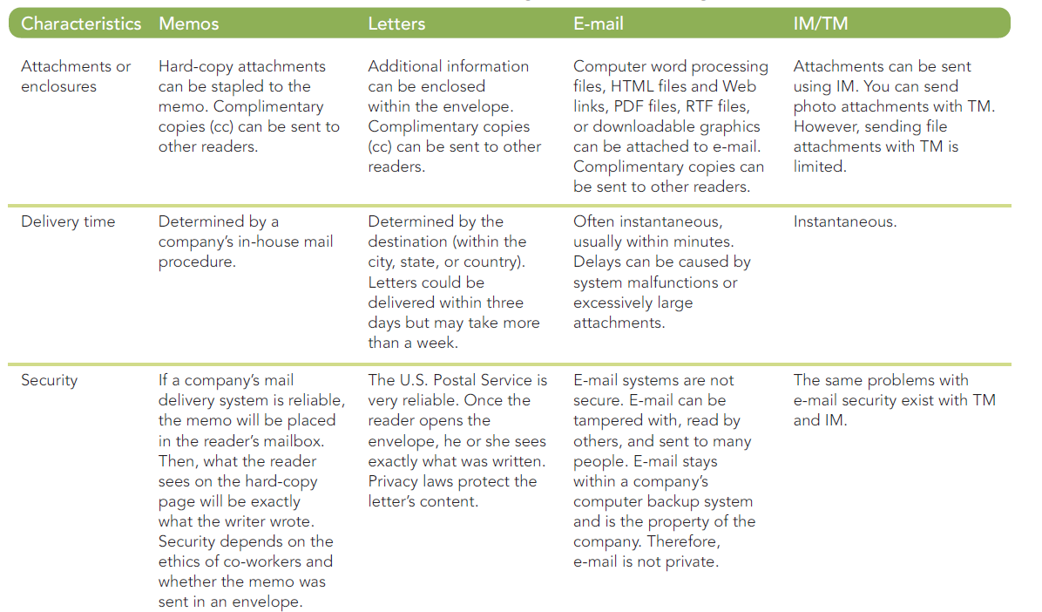
Writing Common Engineering Documents
Instant messages (IM), and text messages(TM),

Slide 13
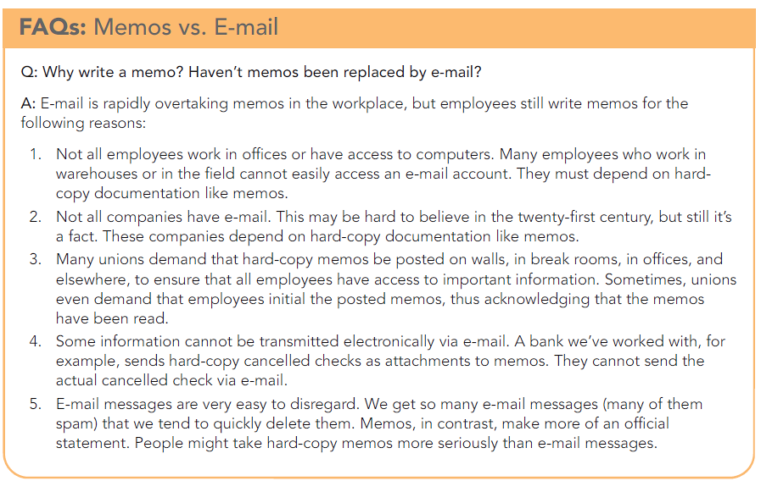

Slide 14
Reasons for Writing Memos:
Documentation
Confirmation
Procedures
Recommendations
Status
Inquiry

Slide 15
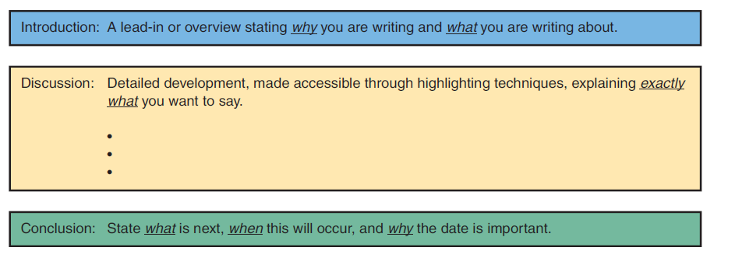
Criteria for Writing Memos
Memos contain the following key components:
Memo identification lines (Date, To, From, and Subject)
Introduction
Discussion
Conclusion

Slide 16
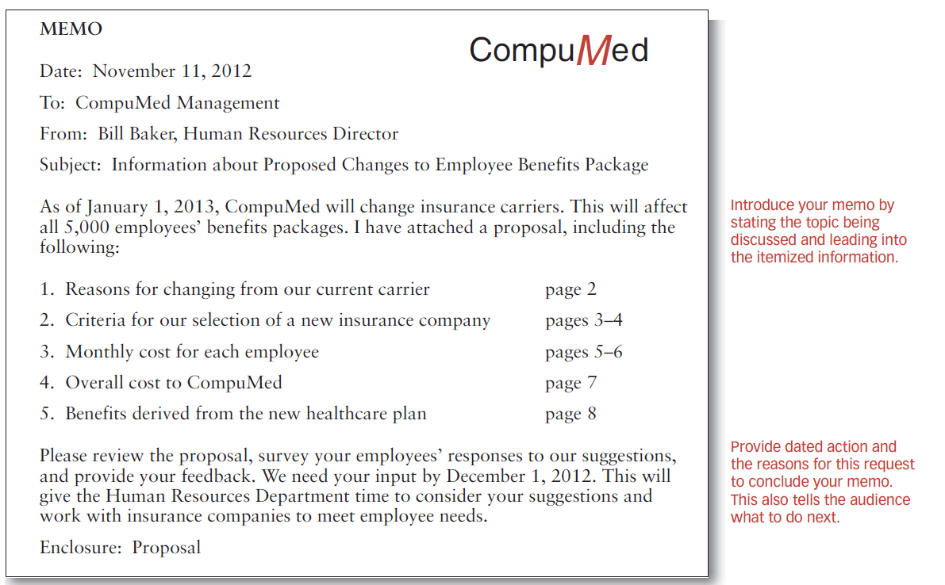

Slide 19
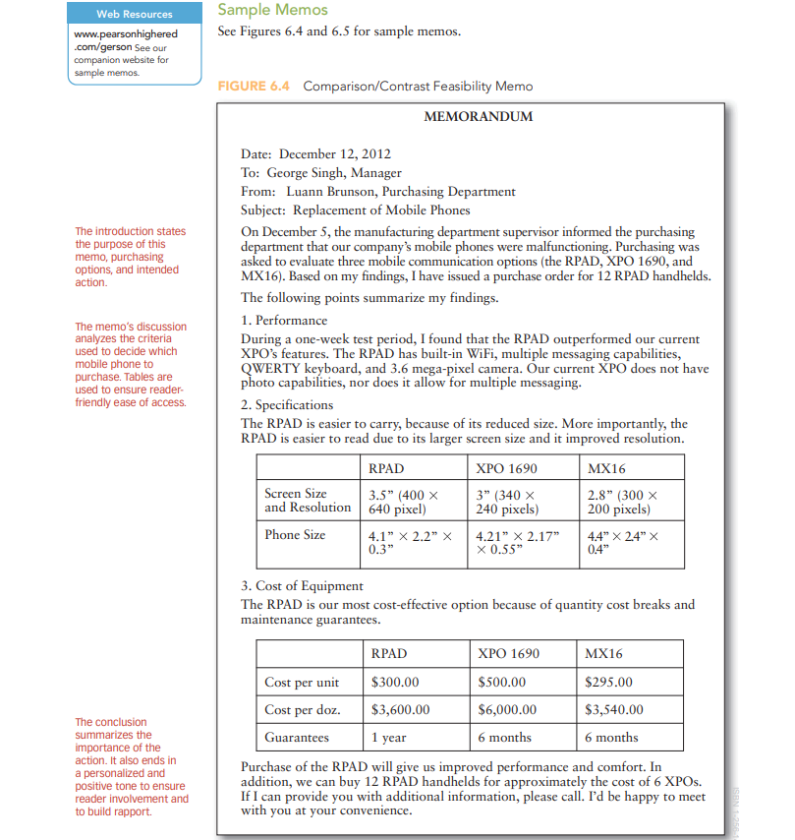

Slide 21
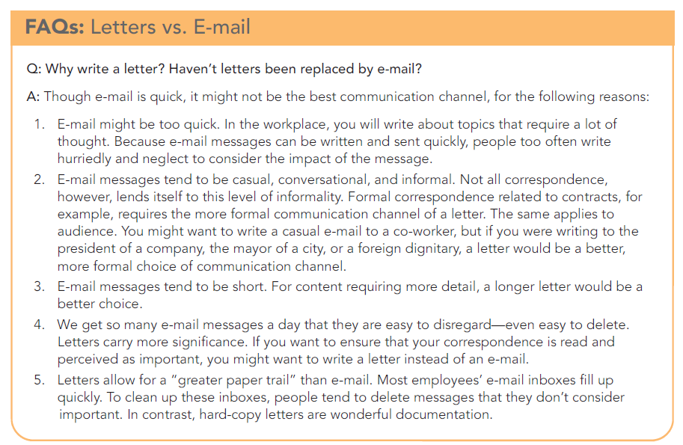

Slide 22
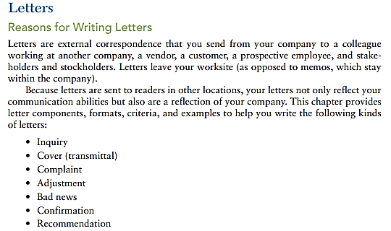

Slide 23
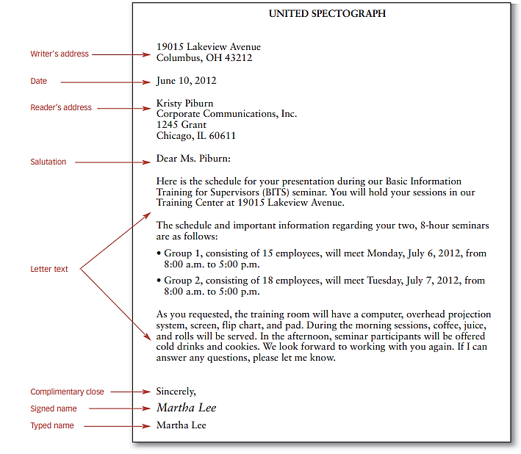

Slide 24
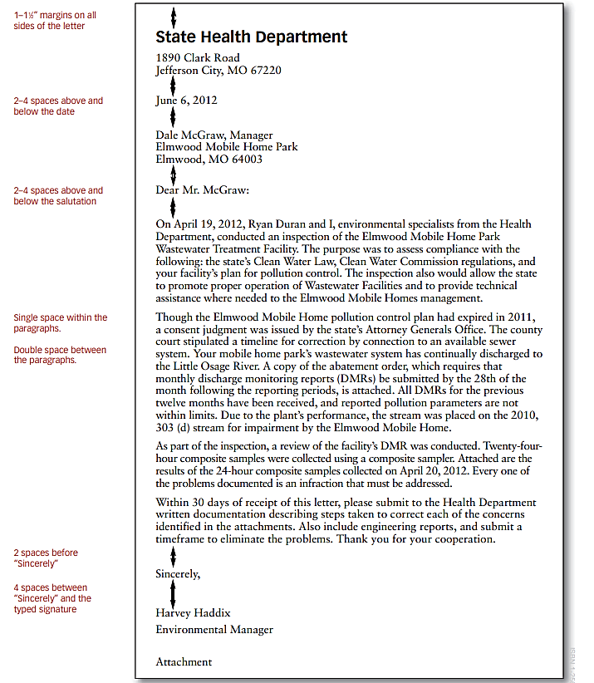

Slide 25
Criteria for Different Types of Letters
Inquiry
Cover Letter
Complaint
Adjustment
Bad news
Confirmation
Recommendation

Slide 26
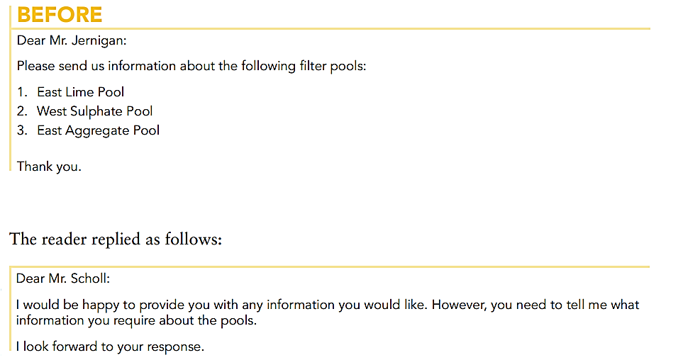
Criteria for Different Types of Letters
Letter of Inquiry

Slide 27
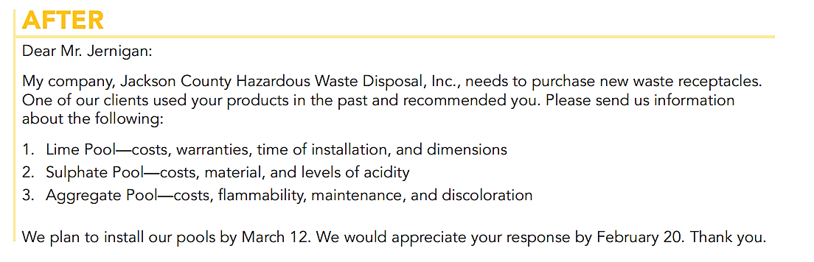
Criteria for Different Types of Letters
Letter of Inquiry

Slide 28
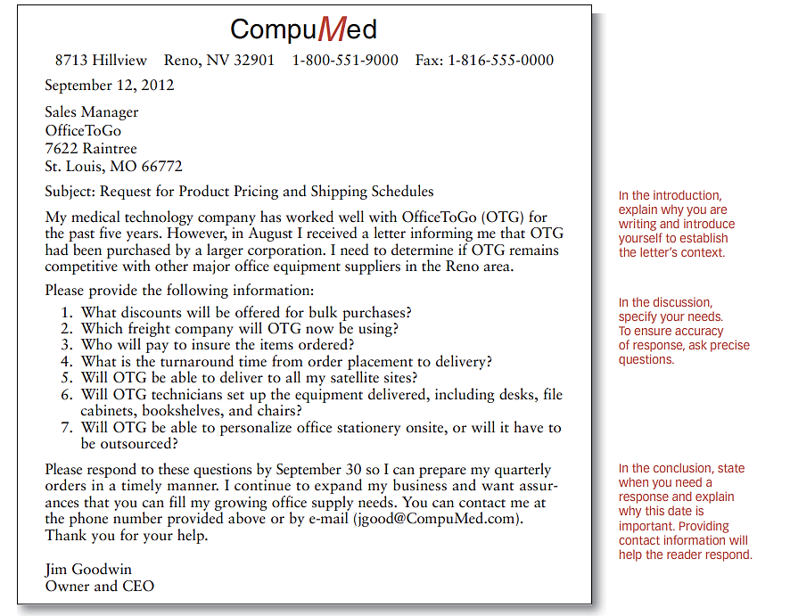

Slide 29
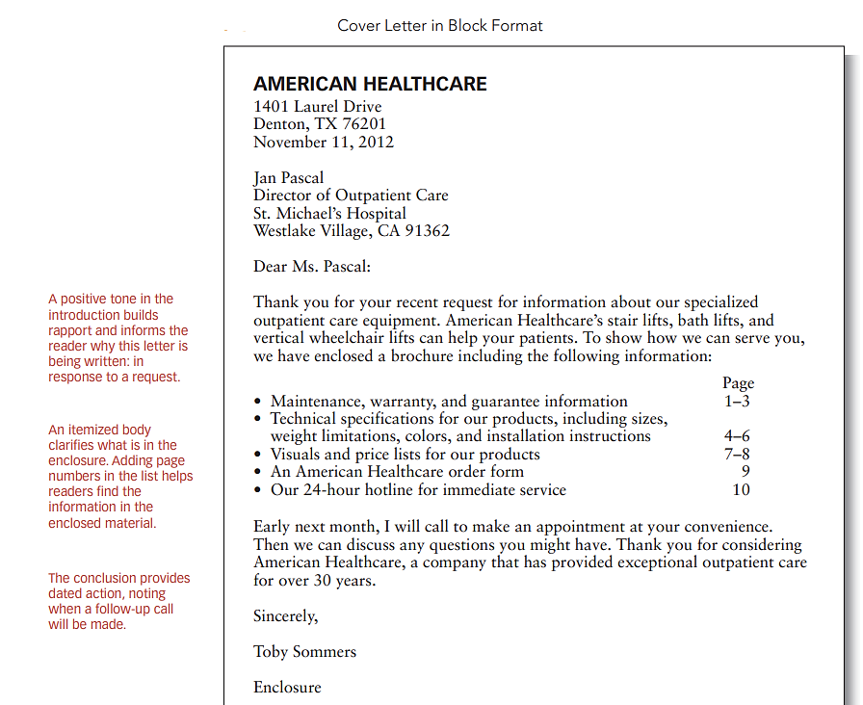
Cover Letter

Slide 30
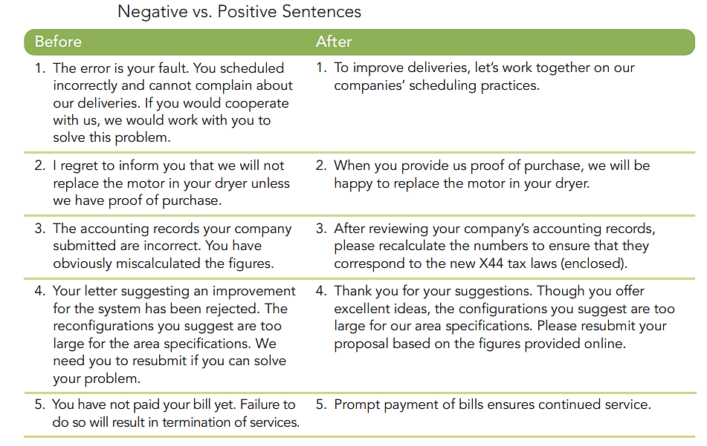
Complaint Letters

Slide 31
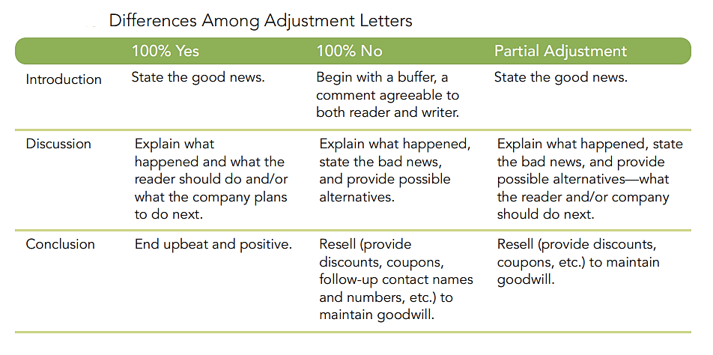
Adjustment Letters

Slide 32
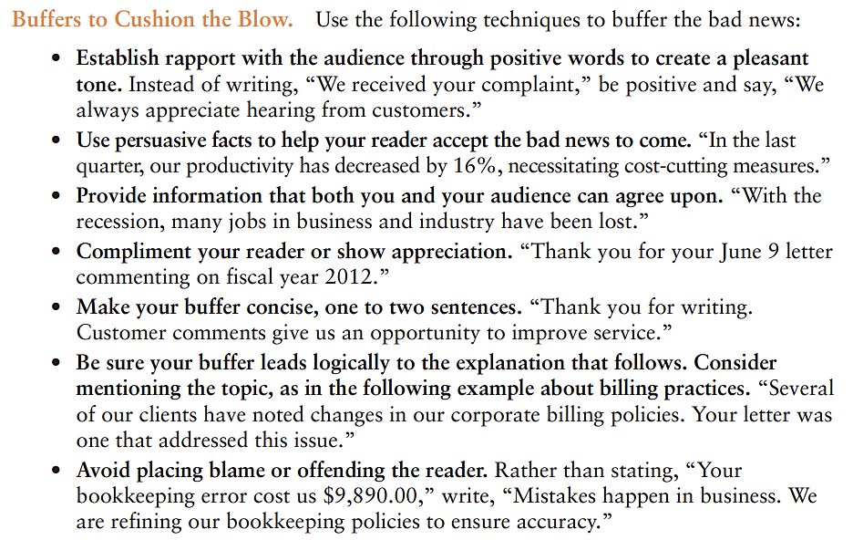

Slide 33
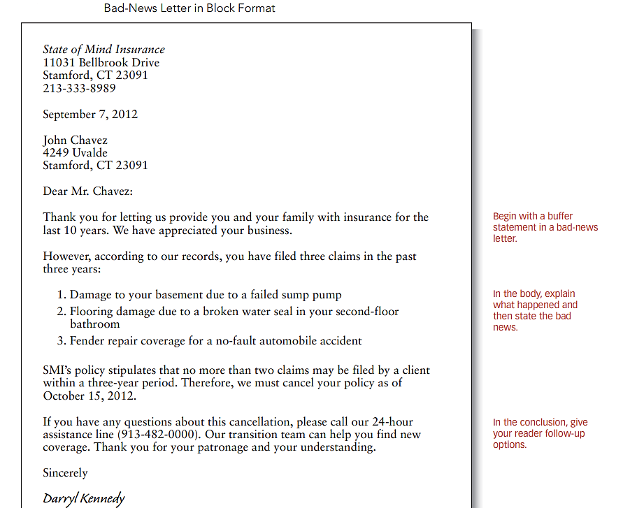

Slide 34
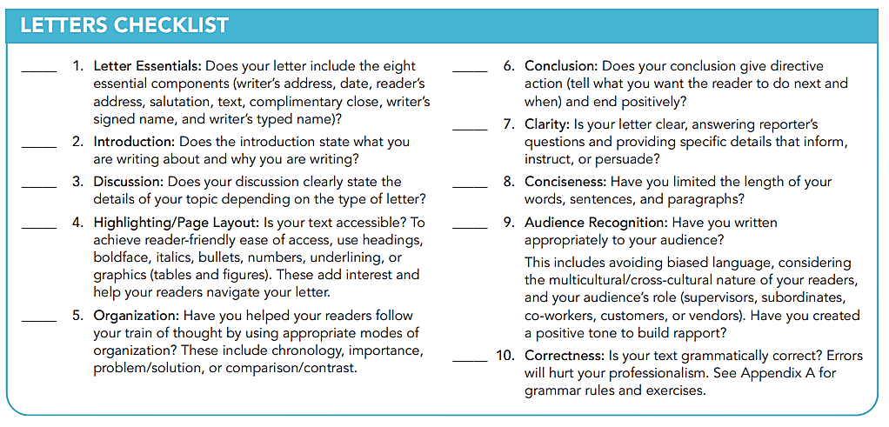

Slide 35
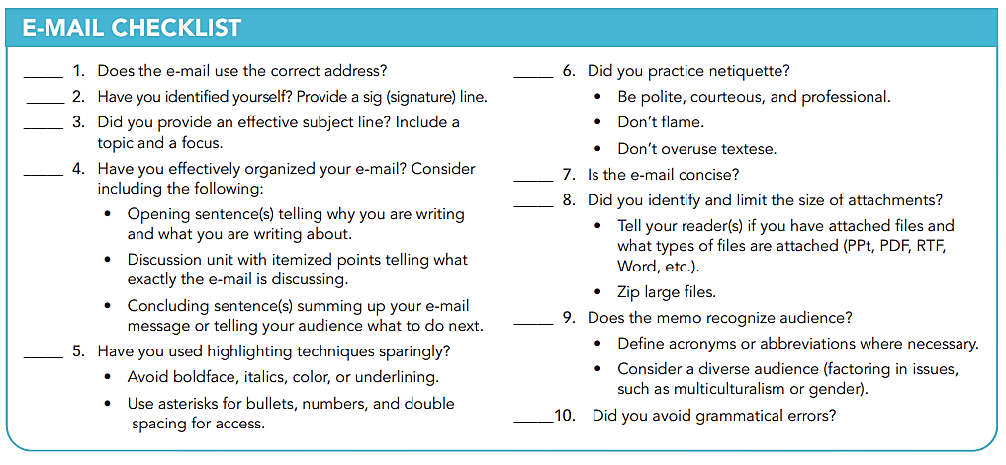

Slide 36
Writing Common Engineering Documents
Common types of reports you may write as an engineer, particularly in terms of their typical content and organization.
1. Inspection or trip reports
2. Laboratory and field reports
3. Specifications
4. Proposals
5. Progress reports
6. Instructions
7. Recommendation reports

Slide 37
Writing Common Engineering Documents
Determine the requirements for the report you must write
Find out your company’s requirements
Think creatively about content and organization
Build your reports on the needs of your audience
Be careful with discussion of technical background
Be careful with the report introduction

Slide 38
INSPECTION AND TRIP REPORTS
One common group of engineering reports handles tasks such as reporting on the:
Inspection of a site or facility;
Describing an incident or accident and exploring the causes, effects, and prevention;
Summarizing events and results of a business trip;
Describing property, equipment, or new technology.
These reports are similar since they contain lots of description, narration, discussion of related causes and effects, as well as a certain amount of interpretation and evaluation.

Slide 39
INSPECTION AND TRIP REPORTS
Trip reports: Discuss the events, findings, and other aspects of a business trip.
This type documents observations so that people in your organization can share them.

Slide 40
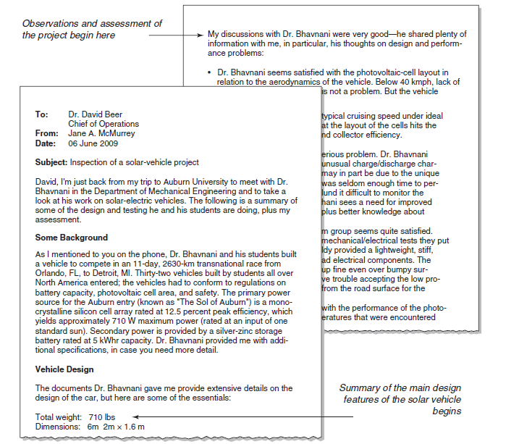
A Short business-trip report
Discuss the events, findings, and other aspects of a business
trip.
This type documents observations so that people in your organization
can share them.

Slide 41
Investigation or accident reports:
Describe your findings concerning a problem; explore its causes, its consequences, and what can be done to avoid it.
Inspection or site reports:
Report your observations of a facility, a property, or an installation of equipment, with description and possibly evaluation of it.

Slide 42
Contents and Organization
For the content of your report, consider these suggestions:
Introduction
Background For the content of your informal report, consider these suggestions:
Factual Discussion
Actions Taken
Interpretive, Evaluative, or Advisory Discussion

Slide 43
LABORATORY AND FIELD REPORTS
Laboratory and field reports present not only the data from an experiment or survey and the conclusions that can be drawn from that data, but also the theory, method, procedure, and equipment used in that experiment or survey.

Slide 44
LABORATORY AND FIELD REPORTS
Contents and Organization:
Introduction
Background
Literature Review
Theory, Method, Procedure, and Equipment
Observations, Data, Findings, and Results
Conclusions
Implications and Further Research
Information Sources

Slide 45
SPECIFICATIONS
Specifications are descriptions of products or product requirements. They provide details for the design, manufacture, testing, installation, and use of a product.
When you write specifications, accuracy, precision of detail, and clarity are critical.
Poorly written specifications can cause a range of problems and lead to lawsuits.

Slide 46
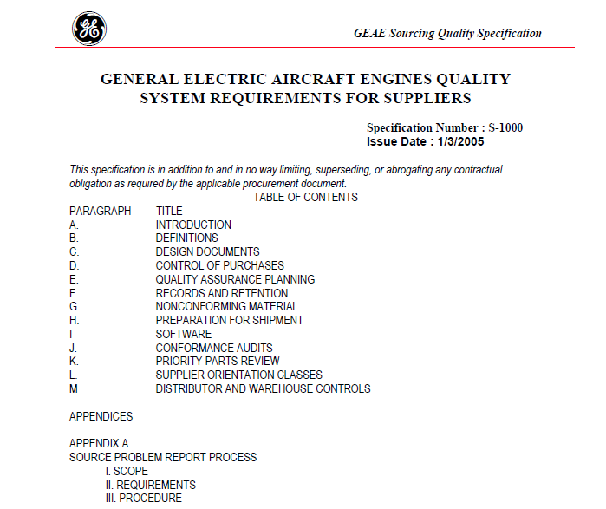
Published reports, specifications, manuals, … of big companies like General Electric, Boeing, Intel, and many others, can be used as templets of professional technical writing.

Slide 47
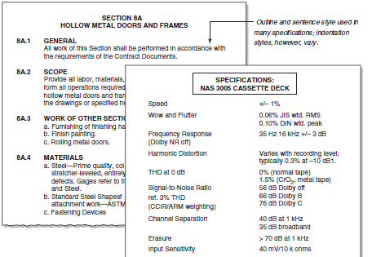
Specifications- excerpts. Outline and two-column style are commonly used to present information in specifications.

Slide 48
SPECIFICATIONS
Use two-column lists or tables to list specific details.
In sentence-style specifications, make sure each specific requirement has its own separate sentence.
• Provide numerical specifications in both words and symbols: for example, ‘‘the distance between the two components shall be three centimeters (3 cm).’’
Make sure your specifications are complete.

Slide 49
PROPOSALS
One of an engineer’s most important tools, particularly a consulting engineer, is the proposal.
In the typical proposal scenario, an organization sends out a request for proposals (RFP) to do a project.
Proposal writing is a competitive affair. You must highlight your organization’s strengths.

Slide 50
Types of Proposals
Proposals are commonly divided into two types, based on whether the recipient requested them:
Solicited. If an organization issues a request for proposals, the proposals are said to be ‘‘solicited’’—they have been requested.
Unsolicited. Individuals and companies often initiate proposals without formal request from the recipients.

Slide 51
Types of Proposals
Proposals can also be divided according to the context in which they occur:
Internal. If you address your proposal to someone within your organization, format and contents change significantly.
External. If you address your proposal to an organization outside of your own, you must present your qualifications and use some combination of the business-letter and formal-report formats.

Slide 52
Proposals’ organization and content
Introduction
Background
Actual Proposal Statement
Description of the Work Product
Benefits and Feasibility of the Project
Method or Approach
Qualifications and References
Schedule
Costs
Conclusion

Slide 53
PROGRESS REPORTS
Another common report type is variously called the progress report, status report, interim report, quarterly report, or monthly report.
Its job is to present to your clients or associates the status of the work you are doing for them.
It is very similar to your project report!

Slide 54
Contents and Organization of Progress Reports
Introduction
Project Description
Progress Summary
• Time-periods approach
Project-tasks approach
Combined approach
Problems Encountered
Changes in Requirements
Overall Assessment of the Project

Slide 55
INSTRUCTIONS
In your engineering career, you may often find yourself writing step-by-step procedures for employees, colleagues, customers, or clients.
Critical in instructions writing is putting yourself in your readers’ place, making no unwarranted assumptions about their background or knowledge.

Slide 56
Contents and Organization of INSTRUCTIONS
Introduction. In the introduction, include some combination of the following:
• Subject. Indicate the procedure you’ll explain.
• Product. If you are providing instructions for a product, identify it.
• Audience. Indicate knowledge or background your readers need in order to understand your instructions. If no special background is needed, indicate that as well.
• Overview. Briefly list the main contents of the instructions; for example, list the major tasks or procedures to be presented.

Slide 57
Contents and Organization of INSTRUCTIONS
Equipment and Supplies. List the supplies and equipment that readers must gather before they begin.
Structure of the Instructions. Before you dive into the step-by-step discussion, identify the tasks in the procedure.

Slide 58
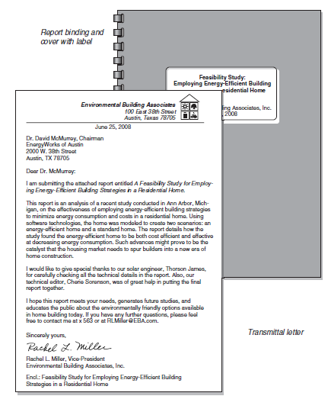
LETTER OF TRANSMITTAL
The transmittal letter is a cover letter.
It is either attached to the outside of the report or bound within the report.

Slide 59
LETTER OF TRANSMITTAL
First paragraph. Cites the name of the report, putting it in italics. It also mentions the reason for the report and the date it was assigned.
Second paragraph. Focuses on the purpose of the report and gives a brief synopsis of the contents of the report.
Third paragraph. Acknowledges any funding or help by other people, and also mentions any limitations or omissions in the report.
Final paragraph. Closes with a gesture of good will, expressing hope that the reader finds the report satisfactory.
It also encourages the reader to get in touch with any questions, comments, or concerns, and gives contact information.

Slide 60
COVER AND LABEL
If your report is over ten pages, bind it in some way and create a label for the cover.
Covers give reports a solid, professional look as well as protection.
Labels: Be sure to devise a label for the cover of your report. It’s a step that some report writers forget. Without a label, a report is anonymous; it gets ignored.

Slide 61
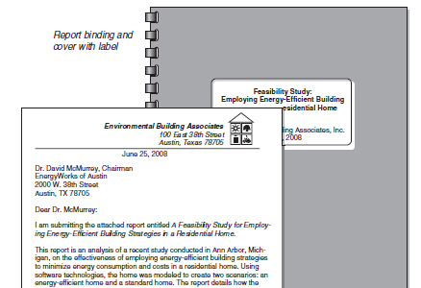
Transmittal letter and report front cover

Slide 62
PAGE NUMBERING
• All pages in the report (within but excluding the front and back covers) are numbered; however, on some pages, the numbers are not displayed.
• In the contemporary design, all pages throughout the document use Arabic numerals; in the traditional design, all pages before the introduction (first page of the body of the report) use lowercase roman numerals.
• On special pages, such as the title page and page one of the introduction, page numbers are not displayed.

Slide 63
ABSTRACT AND EXECUTIVE SUMMARY
•Most engineering reports contain at least one abstract—sometimes two, in which case the abstracts play different roles.
Descriptive abstract: Provides an overview of the purpose and contents in the report.
Executive summary: Summarizes the key facts and conclusions contained in the report.

Slide 64
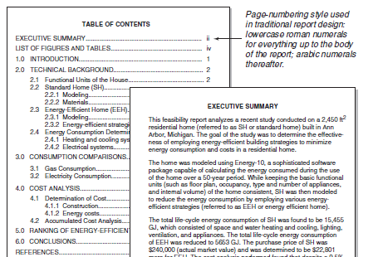

Slide 65
EXECUTIVE SUMMARY
•Typically, executive summaries are one-tenth to one-twentieth the length of reports 10 to 50 pages long.
For longer reports, over 50 pages, the executive summary should not go over three typewritten pages.
The point of the executive summary is to provide a summary of the report—something that can be read quickly.

Slide 66
TABLE OF CONTENTS (TOC)
•How many levels of headings to include.
In longer reports, don’t include all of the lower-level headings.
• Indentation, spacing, and capitalization. E Each of the three levels of headings are aligned with each other.
• Vertical spacing. The first-level sections have extra space above and below, which increases readability.

Slide 67
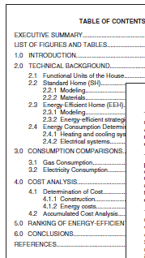
TABLE OF CONTENTS (TOC)
•
Levels of headings
Indentation, spacing, and capitalization
Vertical spacing

Slide 68
LIST OF FIGURES AND TABLES
In an engineering report, the introduction prepares the
reader to read the main body of the report.
Introduction discusses:
• Specific purpose and topic of the report.
• Intended audience
• Situation that brought about the need for the report.
• Scope of the report—topics covered as well as topics not covered
• Background

Slide 69
Clarity of Writing Style
Unnecessary Passive Voice.
Overreliance on the Be Verb (Nominalization).
There is a Pizza Hut in Jefferson City that attracts all the teenagers.
The local Pizza Hut attracts all the town's teenagers.
Unnecessary Expletives.
Expletives use some form of ‘‘it is’’ or ‘‘there is.’’
It is the results of studies of the central region of the M87 galaxy…
Results of studies of the central region of the M87 galaxy show that….

Slide 70
Clarity of Writing Style
Redundant Phrasing.
With reference to the fact that the company is deficient in manufacturing and production space, the contract may in all probability be awarded to some other enterprise.
The company may not be awarded the contract because it lacks production facilities.
Noun Stacks
Cocombustion-chamber exit gas temperatures…
The temperature of gas exiting the cocombustion chamber

Slide 71
CONCLUSIONS
• Conclude. Draw logical conclusions from the discussion that has preceded; make inferences on the data that has been presented.
• Summarize. Review the key points, key facts, and so on from the preceding material.
• Generalize. Move away from the specific topic of the report to a general discussion of such implications, applications, and future developments—but only in general terms.

